Slide 1
Mechanism for handling- Multi link failure in SLICE
Rakesh Praneeth
Prakash Chourasia
Niharika Deekonda

Slide 2
Content
Introduction
Spectrum-Sliced elastic optical path Network
Problem : Link Failure
Bandwidth Squeezing Restoration(BSR)
Shared Path Protection
DLBSPP
Self Adaptive Restoration
Analysis And Simulation
Conclusion
Notes:
In introduction

Slide 3
Introduction
Our research is focusing on optimizing the protection schemes available for link failure in optical networks.
Using SLICE- a optical network architecture, as it is efficient and scalable with its possible bandwidth variation and other capabilities.
Analyzed the performance of Shared Path Protection and studied single link protection.
For multiple link failure we have TSAR, we propose a new solution which is combination of TSAR and DLBSPP for better results in terms of Blocking Probability and spectrum utilization ratio.

Slide 4
Spectrum-Sliced elastic optical path Network
SLICE- Spectrum-Sliced elastic optical path Network
It alleviates the stranded bandwidth issue of current wavelength routed optical path networks
It allocates the appropriate sized optical bandwidth to an end-end optical path.
Allocation is performed according to the traffic volume or user request in a highly spectrum efficient and scalable manner.
The name elastic optical path of the optical paths in SLICE stems from their ability to expand or contract in contrast to the conventional rigid optical path.

Slide 5
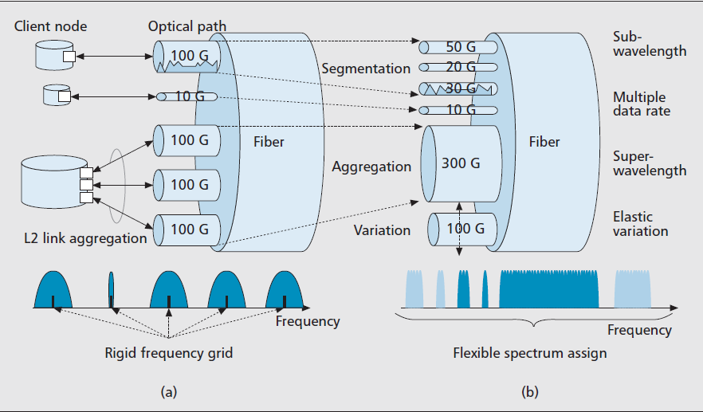
Spectrum assignment in SLICE
a)Conventional optical path network b)SLICE
Segmentation,
Aggregation(super wavelength accommodation),
Multiple data rate accommodation
Notes:
Link aggregation is a packet networking technology standardized in IEEE 802.3 which combines multiple physical ports/links in a switch/router into a single logical port/link to enable incremental growth of link speed as the traffic demand increases beyond the limits of any one single port/link

Slide 6
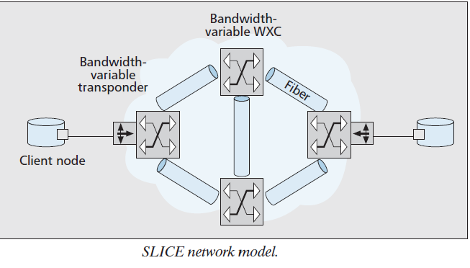
SLICE Network Model
To achieve the high spectral resource utilization in wavelength-routed optical path networks,
Bandwidth-variable transponder generates an optical signal using just enough spectral resource to transmit the client signal while minimizing the separation between adjacent optical paths.
At the same time, every WXC on the route of the optical path allocates a cross-connection with the corresponding, spectrum bandwidth to create an appropriate-sized end-to-end optical path.
Notes:
In optical fiber communications, a transponder is the element that sends and receives the optical signal from a fiber. A transponder is typically characterized by its data rate and the maximum distance the signal can travel.
WXCs-Wavelength Cross Connects

Slide 7
BENEFITS OF SLICE
Time-Dependent Elastic Bandwidth Sharing
The allocated optical bandwidth can shared between the customers with be time-dependent complementary demands.
Energy Efficient Network Operation
During the periods of low link utilization, for example during the nighttime or weekend, SLICE transponders may partially turn off the electrical drivers through decreasing the number of channels and subcarriers.
Bandwidth Squeezed Restoration

Slide 8
Problem : Link Failure
Single Link Failure
Multi-link failures
Solution to above mentioned problem
Protection - plans the backup path/routes well in advance that can be used in case of failures, backup resources are reserved during connection setup
Restoration - solves failures by locating free wavelength channels for backup after a failure occurs, back up routes are discovered dynamically

Slide 9
Protection
Dedicated Back-up Protection :
Network resources need to be dedicated for each failure scenario
Faster restoration time and provide guarantees on the restoration ability
Shared Back-up Protection :
The backup resources reserved along the backup path may be shared with other backup path.
more efficient in utilizing capacity due to the multiplexing of the spare-capacity requirements and provide resilience against different kinds of failures

Slide 10
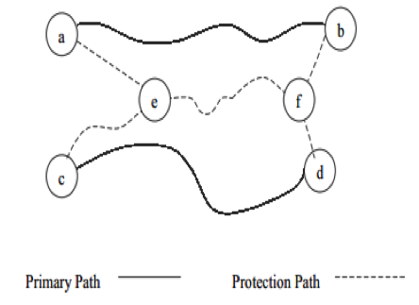
Shared Path Protection
Functionality : similar to that of dedicated protection
Multiple protection (back-up) paths can be established : sharing the same resources.
Increased network utilization.
Drawback And Issues
If the shared recovery path fails, then all those primary paths will have to look for a different path and re-route their data.
Also there is no load balancing mechanism

Slide 11
Bandwidth Squeezed Restoration
Restoration scheme - fixing the link failure with limited bandwidth resources.
For current fixed-bandwidth optical networks, a failed optical path cannot be recovered unless the available bandwidth on the detour route equals or exceeds the original path bandwidth.
By contrast, in SLICE even if the available bandwidth on the detour route is not sufficient, the bandwidth of the failed working optical path is squeezed using the elastic feature of SLICE.

Slide 12
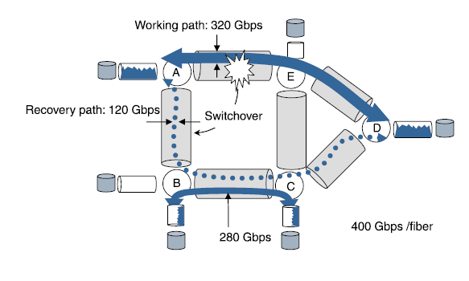
Highly survivable : BSR
a) Bandwidth Squeezed Restoration
Utilizing two key components
Bandwidth Variable transponder
BV-OXCs

Slide 13
Contd..
Data can be recovered by
FBGR(Full Bandwidth Guaranteed Recovery)
PBGR(Partial Bandwidth Guaranteed Recovery)
BER(Best-Effort Recovery)
FBGR:
Allocates same amount of recovery bandwidth as that of the working path bandwidth.

Slide 14
Contd..
PBGR:
Allocates only a partial amount of total working bandwidth to the recovery bandwidth.
BER:
As long as the available bandwidth is sufficient enough for the working path, all the remaining bandwidth is allocated to the backup resources as backup bandwidth until the limit for the bandwidth is reached.
Cost effective and Highly survivable as a restoration scheme .

Slide 15
Dynamic Load Balancing Shared-Path Protection
The Network Architecture can be described as G(N,L,F)|N| represents the number of nodes equipped with bandwidth-variable optical cross-connects (BV -OXCs) function
|L| and |F| the links and the frequency slots
Dijkstra algorithm is used to find primary path and backup path while spectrum resource reservation considers spectral continuity constraint and spectral consecutiveness constraint are considered when assigning frequency slot resource.

Slide 16
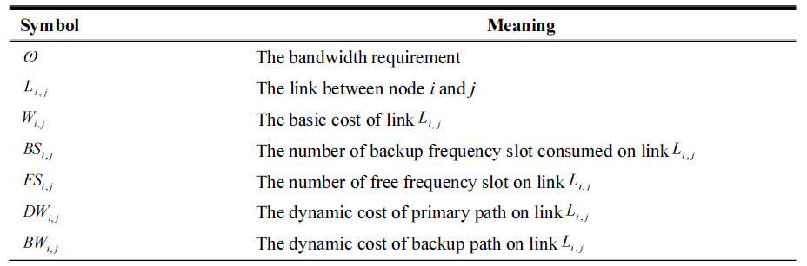
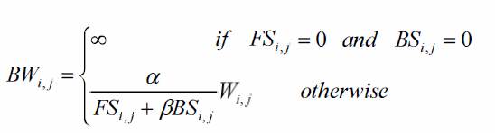
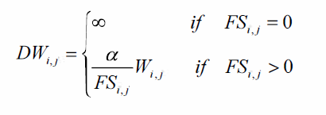
Contd…
Spectral continuity constraint is defined as allocation of the same spectrum on each link along a path.
Spectral consecutiveness constraint is defined as the allocated spectrum must be chosen from contiguous frequency slots in the frequency domain on each link.

Slide 17
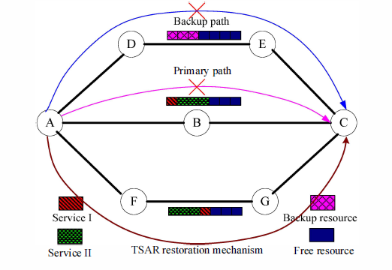
Contd…

Slide 18
Traffic Self Adaptive Restoration
Key Idea
the affected traffic will be classified by priority, i.e., the coarse granularity traffic has the higher priority, the small granularity traffic will be recovered by lower priority;
new routes for carrying the affected traffic can be computed again, so the multi-link failures can be effectively recovered.
Multi-link failures can be efficiently restored

Slide 19
Simulation & Analysis
Compared the Multi-link Failure using the SPP and DLBSPP algorithm.
Consider only the available bandwidth sufficiency in the case of multi-link failure.
Used Dijkstra Algorithm to find the shortest path b/w source and destination.

Slide 20
Contd..
Compared the performance of DLBSPP and SPP
Primary path failure
Primary and Back-Up path failure.

Slide 21
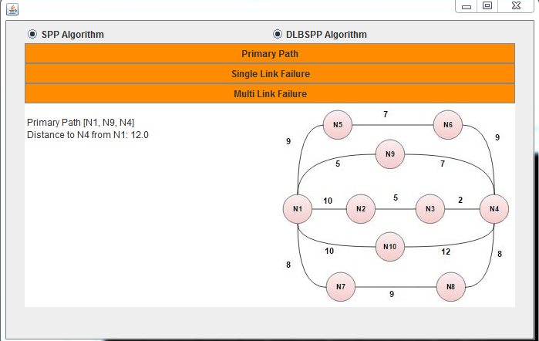
Output

Slide 22
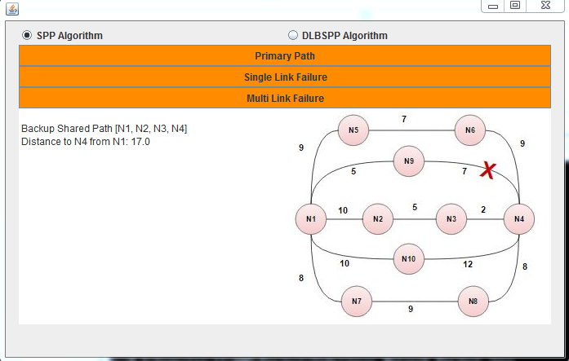
Primary Path Failure

Slide 23
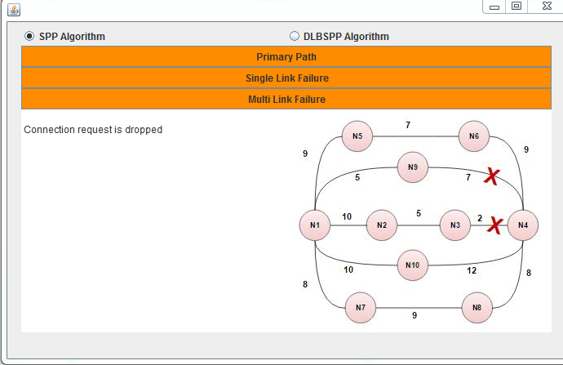
Both Primary and Back-Up path failure in SPP

Slide 24
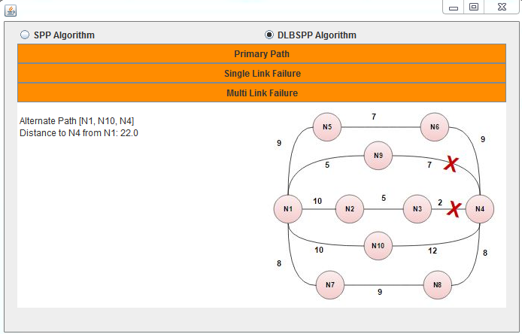
Both Primary and Back-Up path failure in DLBSPP

Slide 25
Conclusion
By analyzing the simulation results we can come to a conclusion that DLBSPP can better handle the real-time link failures compared to SPP
Failure restoration capacity is better in case of DLBSPP.

